Slide 2

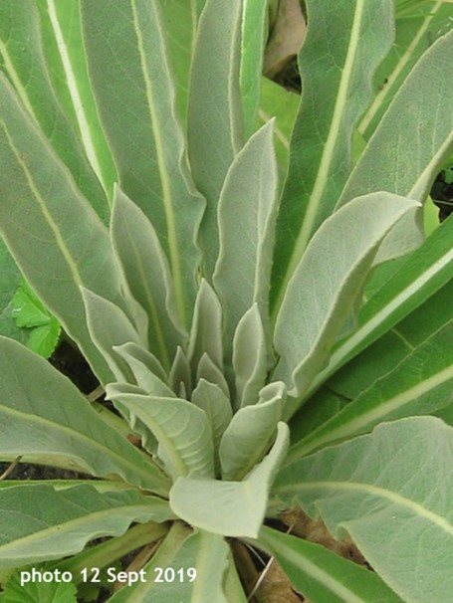
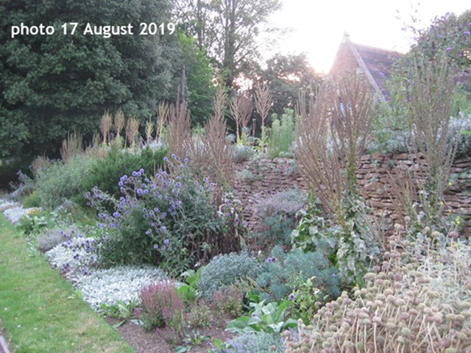
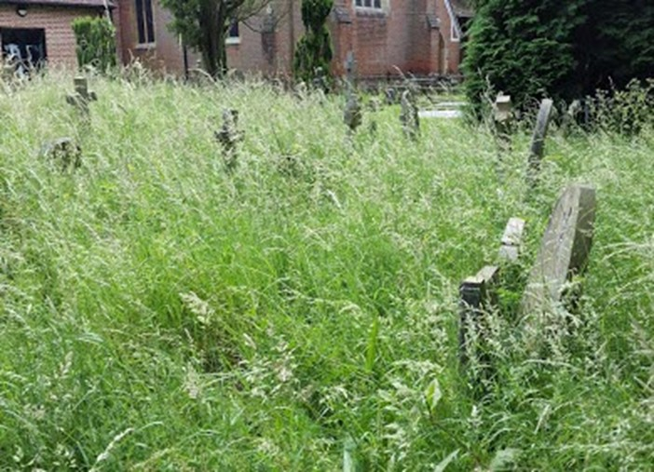
Plants, trees and shrubs in our churchyard
St Johns
(flora)

Slide 3
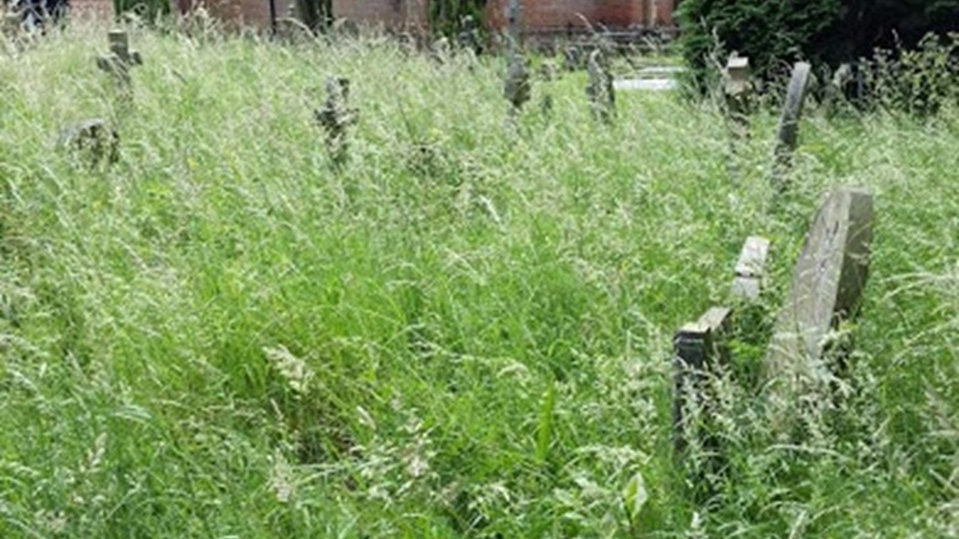
Children's Ministry Churchyard Quiz
Jasper & Jessica
Part 1

Slide 4
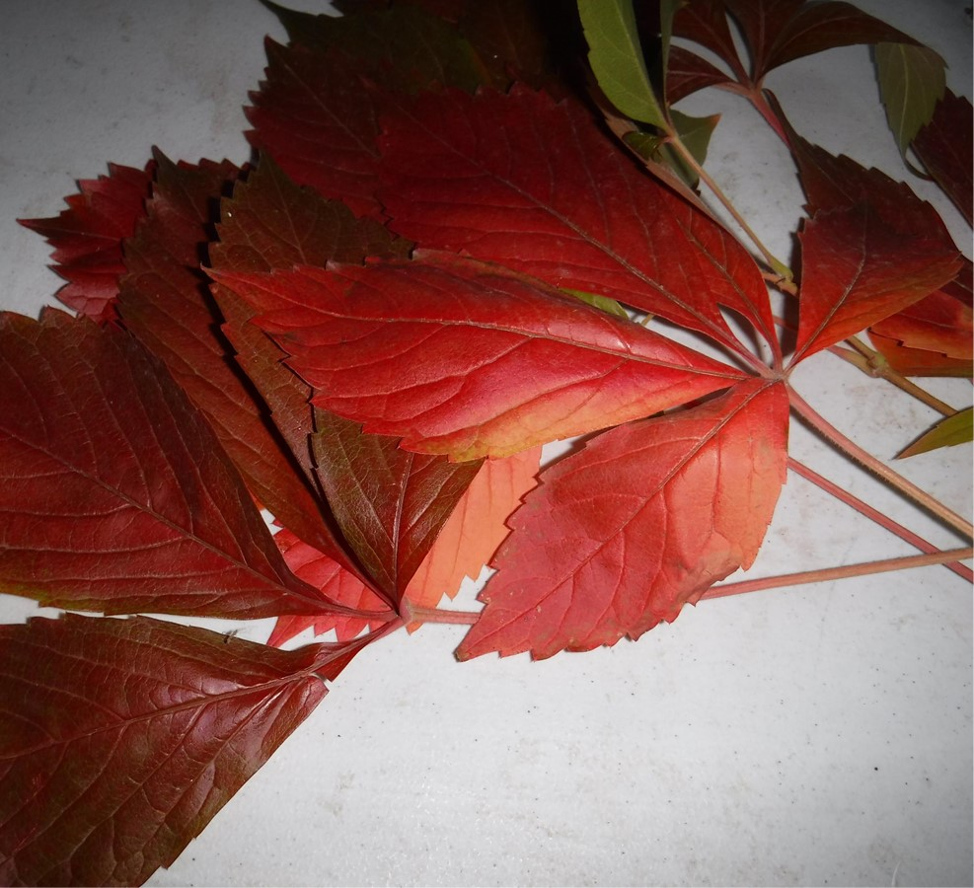
Can you name this plant?
X Try again
Maple
X Try again
HOLMS OAK
Virginia Creeper
X Try again
Horse Chestnut
Click here for a clue..
This plant is sometimes known as five-leaved or five-finger ivy.
Click on the answer to submit

Slide 5
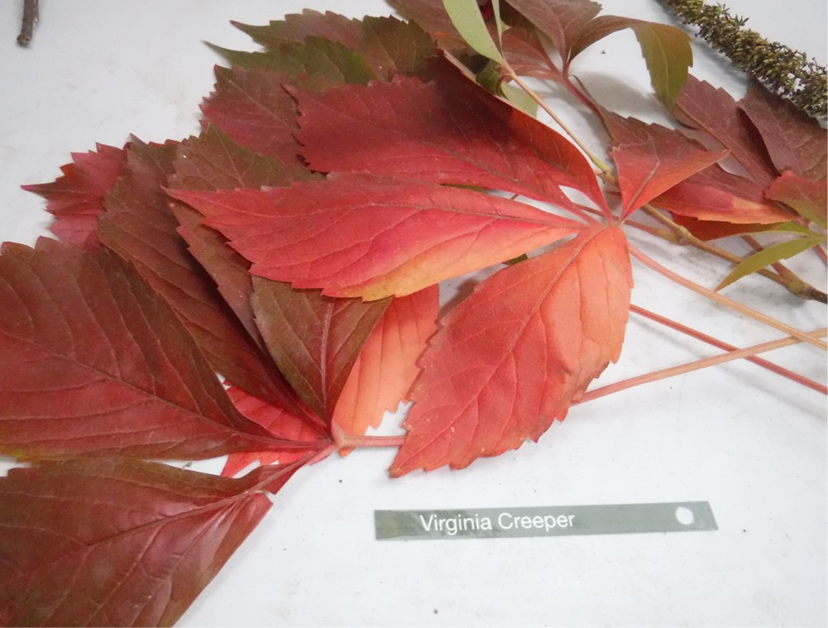

Well done!!
Virginia Creeper plant is sometimes known as five-leaved or five-finger ivy.
Click to continue

Slide 6
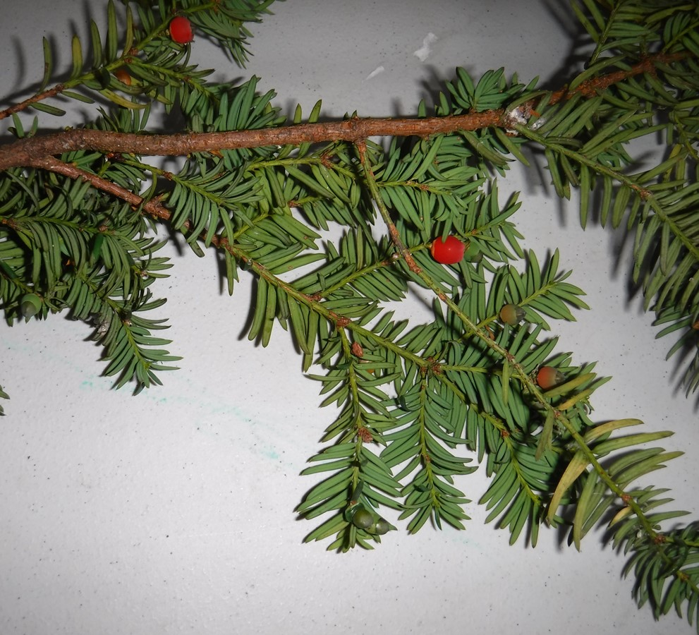
Can you name this Tree?
X Try again
Mistletoe
X Try again
Holly
Cedar
X Try again
Yew
The berries contain seeds which are poisonous to humans, but a favourite snack for Blackbirds.
Click here for a clue..
Click on the answer to submit

Slide 7

Well done!!
Yew berries contain seeds which are poisonous to humans, but a favourite snack for Blackbirds.
Click to continue
Yew Tree

Slide 8
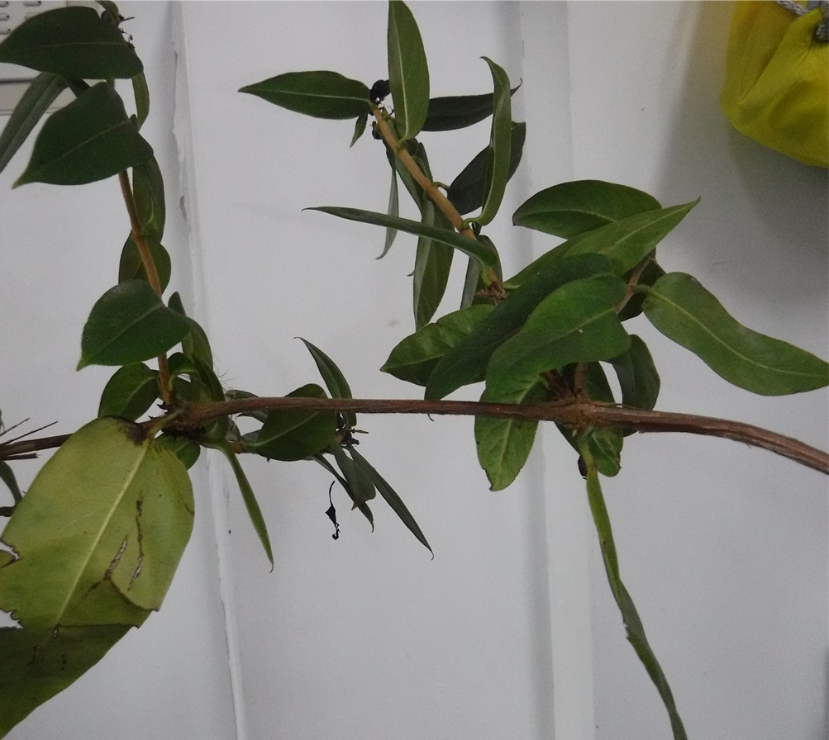
Can you name this shrub?
X Try again
GORSE
X Try again
KNAPWEED
Honeysuckle
X Try again
HEMP
This shrub is renowned for its colourful, fragrant flowers which attract many insects
Click here for a clue..
Click on the answer to submit

Slide 9
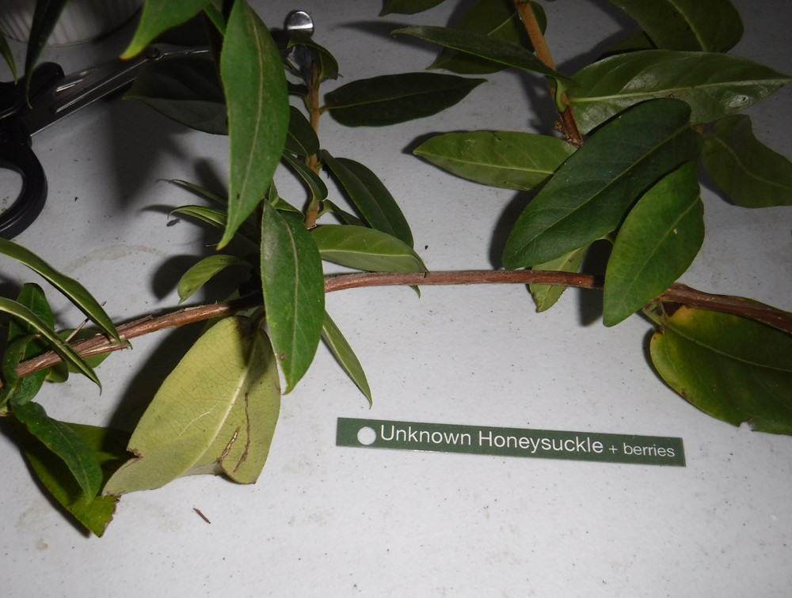
Well done!!
There are many types of Honeysuckle.
Honeysuckle is renowned for its colourful, fragrant flowers which attract many insects.
Click to continue
Honeysuckle

Slide 10
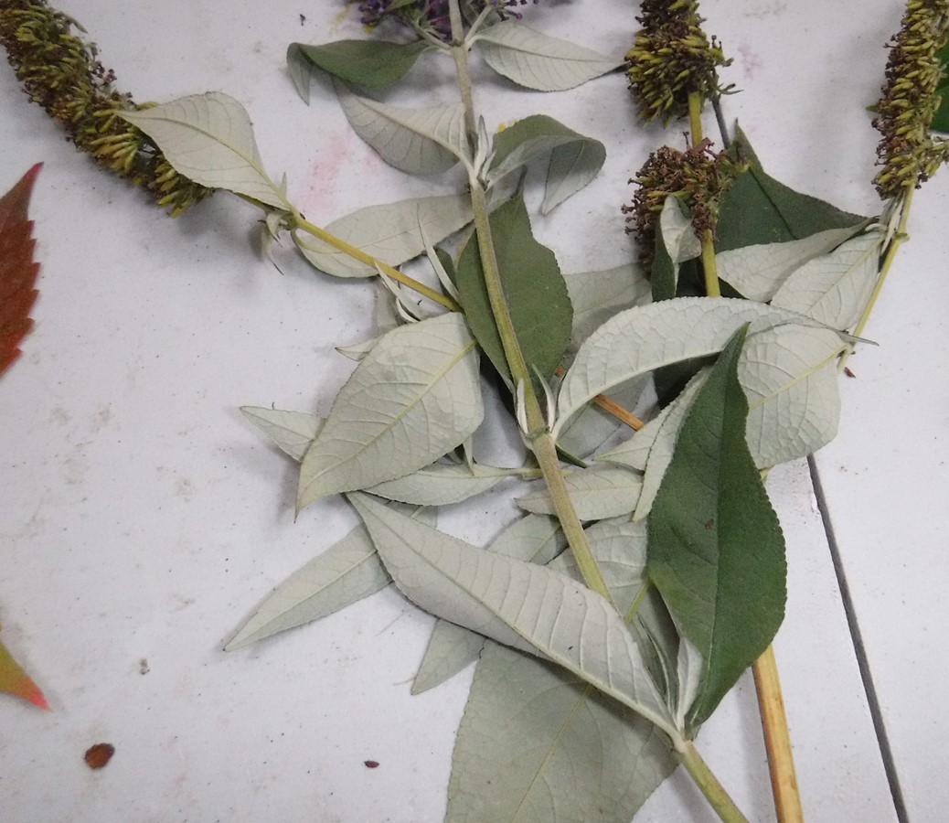
Can you name this PLANT?
Buddleia
X Try again
Lilac
X Try again
Wisteria
X Try again
Hogweed
Sometimes known as the butterfly bush, this plant is a magnet for butterflies.
Click here for a clue..
Click on the answer to submit

Slide 11
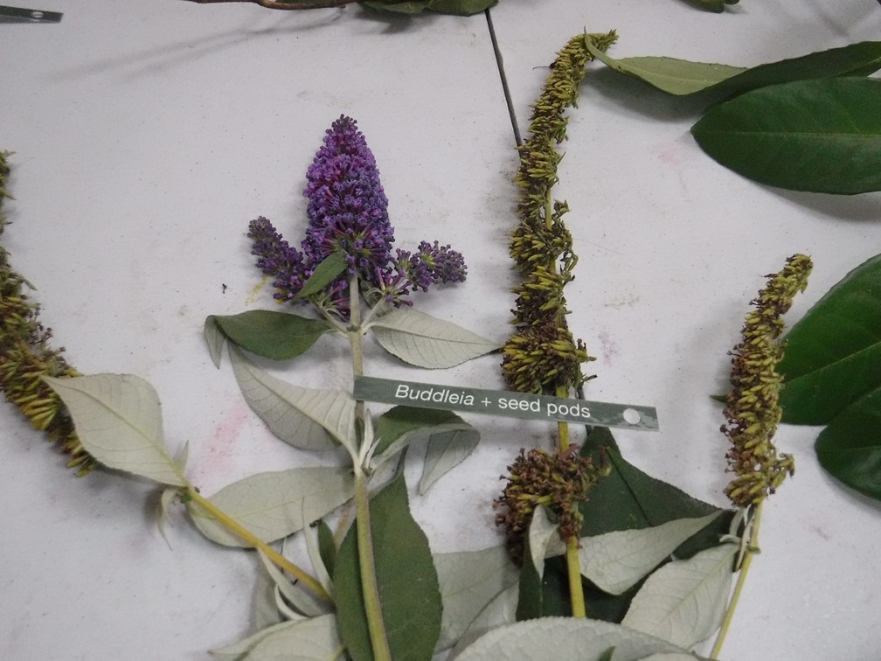
Well done!!
Buddleia is sometimes known as the butterfly bush, this plant is a magnet for butterflies.
We are lucky . There are many species of butterfly in our churchyard.
Buddleia
Click to continue

Slide 12
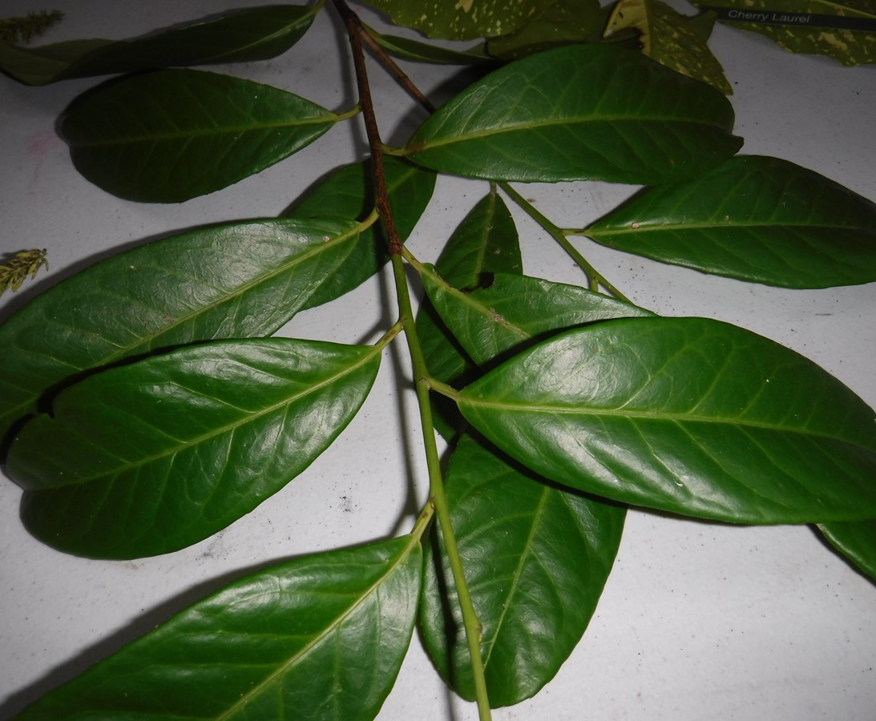
Can you name this PLANT?
Laurel
X Try again
Cypress
X Try again
Privet
X Try again
Sycamore
This an evergreen plant with large, shiny, green leaves. It grows up to 30ft tall.
Click here for a clue..
Click on the answer to submit

Slide 13
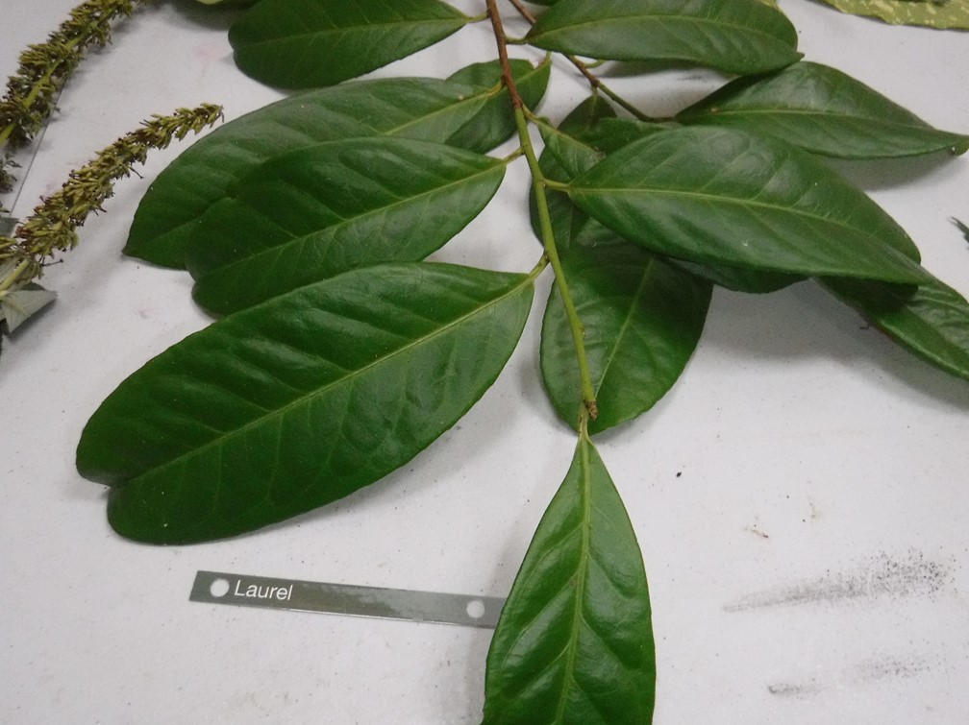
Well done!!
Laurel is an evergreen plant with large, shiny, green leaves. It grows up to 30ft tall.
The Laurel is native to the Mediterranean region and is used as bay leaf for seasoning in cooking.
Laurel
Click to continue

Slide 14

Children's Ministry Churchyard Quiz
Oscar
Part 2

Slide 15
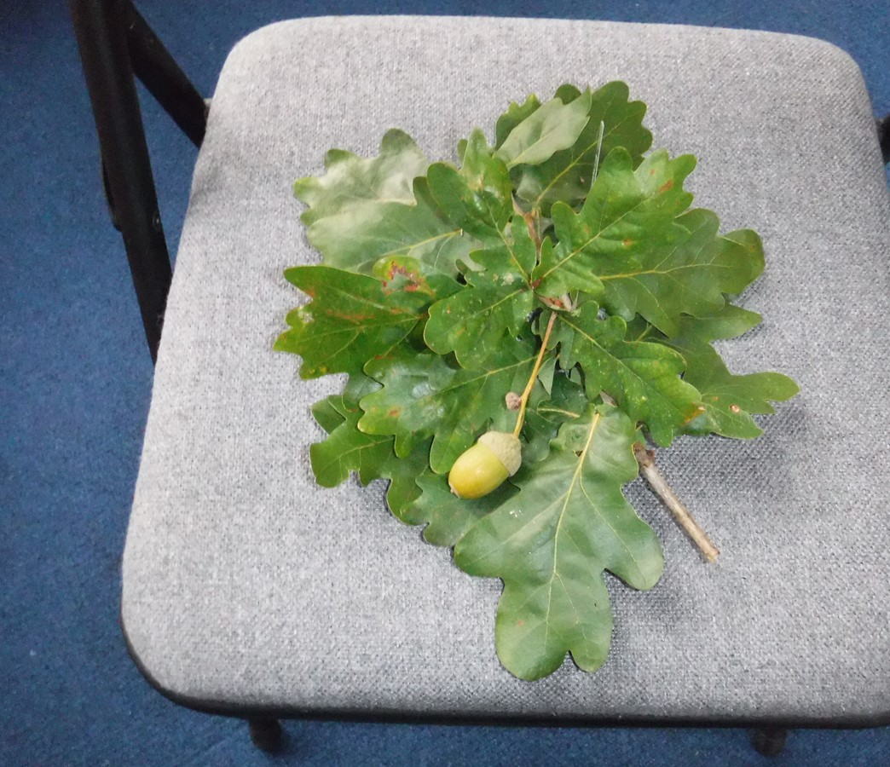
Can you name this Tree?
X Try again
Elm
English oak
X Try again
Ash
X Try again
Horse Chestnut
Click here for a clue..
These trees can live up to 1000 years, but generally mature at 75.
Click on the answer to submit

Slide 16
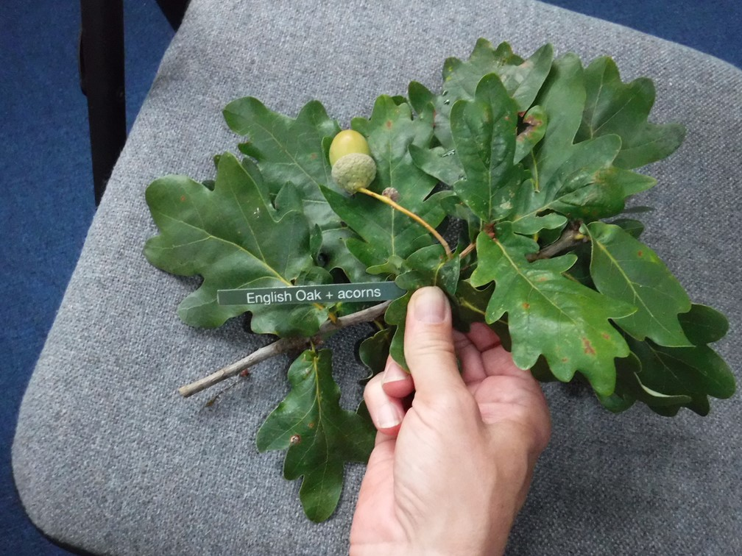
Well done!!
English Oaks can live for up to 1000 years. They start to produce acorns when they are about 40 years old.
English oak
Click to continue

Slide 17
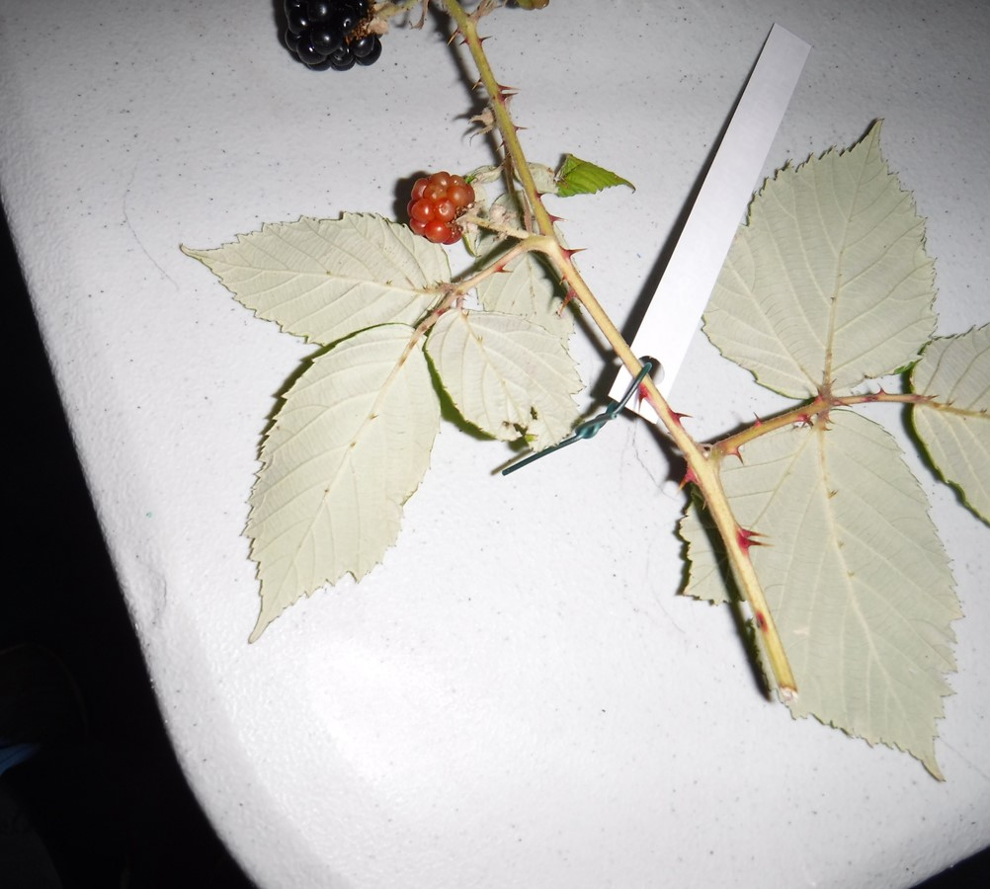
Can you name this plant?
X Try again
Brier
X Try again
Loganberry
X Try again
Cloudberry.
Bramble
Click here for a clue..
The berries on this plant are popular in many English puddings.
Click on the answer to submit

Slide 18
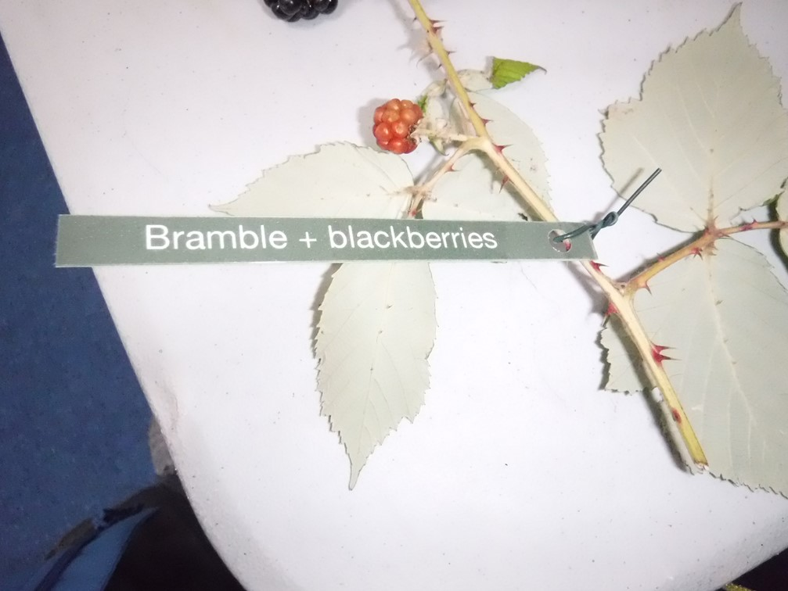
Well done!!
Blackberries are known by a variety of names, which include brambleberries, bramble, dewberry, thimbleberry and lawers.
The dark blue colour ensures blackberries have one of the highest antioxidant levels of all fruits. Antioxidants, well-known for lowering the risk of a number of cancers.
Bramble & Blackberries
Click to continue

Slide 19
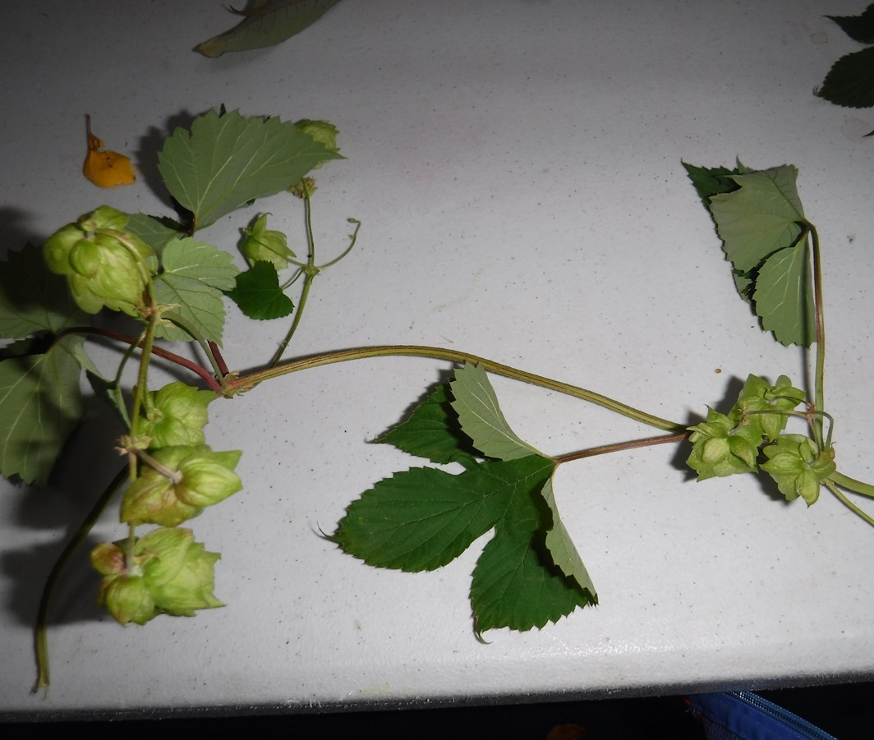
Can you name this plant?
X Try again
maple
X Try again
Elder
Hop Plant
X Try again
Hawthorn
Click here for a clue..
This plant is fast-growing vine that grows 1 to 3 inches per day and reaches 6 to 50 feet in height per season.
Click on the answer to submit

Slide 20
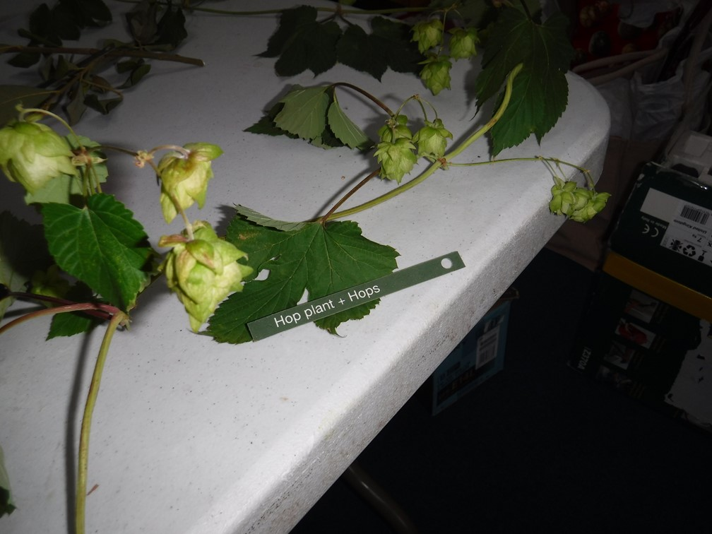
Well done!!
Used to make beer!
Common hop is fast-growing vine that grows 1 to 3 inches per day and reaches 6 to 50 feet in height per season. It has rough, twining stem filled with milky sap.
Hop Plant & Hops
Click to continue

Slide 21
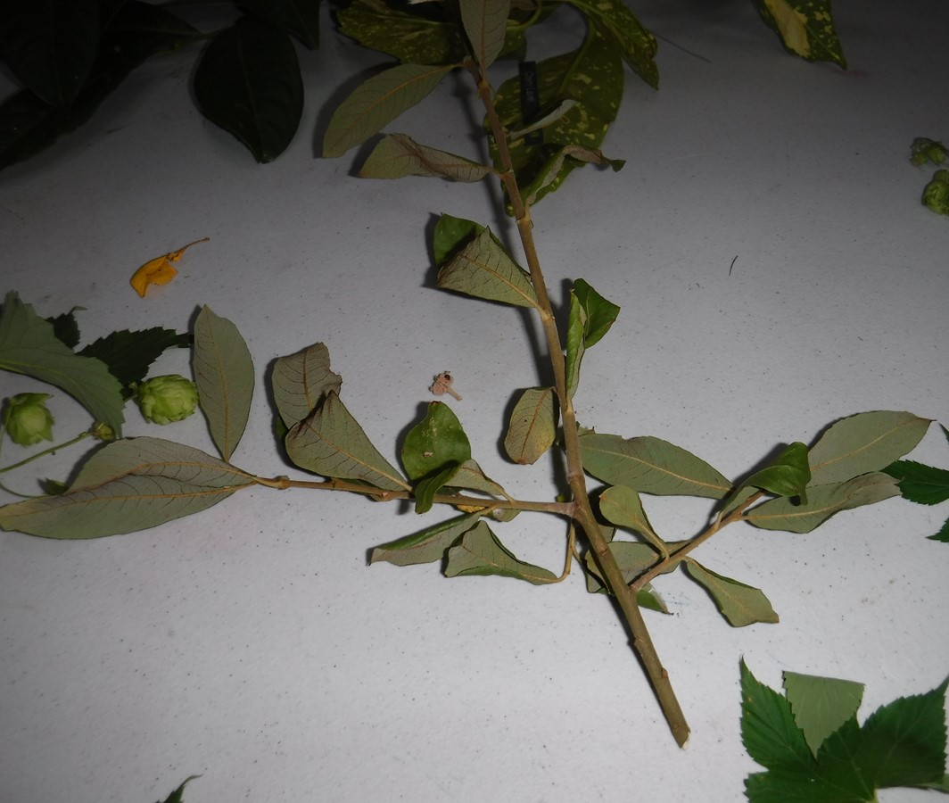
Can you name this plant?
X Try again
elder
Sallow
X Try again
Ash
X Try again
elm
Click here for a clue..
This plant is sometimes known as Goat Willow or Pussy willow.
Click on the answer to submit

Slide 22
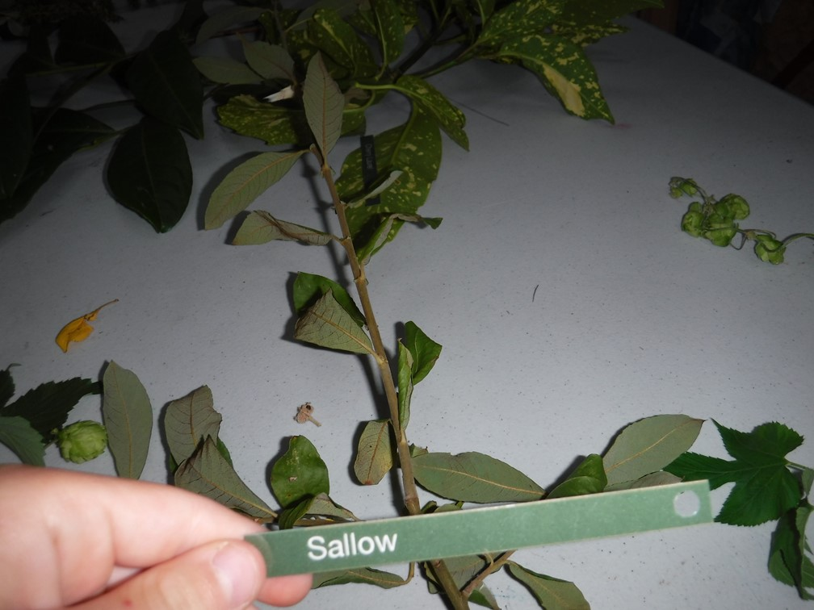
Well done!!
One of the more common trees you'll find in our Scottish woodland is the ancient Sallow, (Salix caprea) commonly known as Goat Willow or Pussy Willow . ... The Salix or Willow genus is a huge cornucopia of trees and shrubs.
Sallow
Click to continue

Slide 23
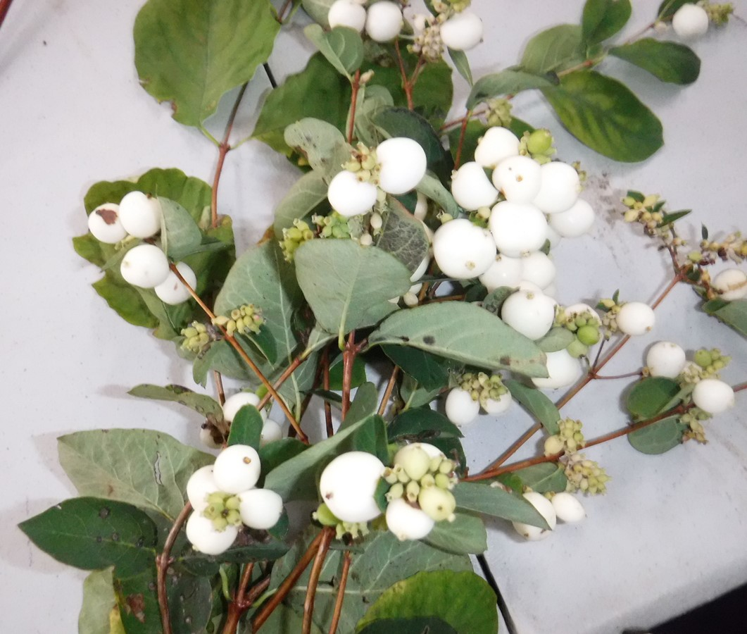
Can you name this plant?
X Try again
elder
X Try again
SLOE
X Try again
Mulberries
snowberries
Click here for a clue..
This shrub, grows 1-3 m high. It spreads by suckers and forms large thickets in the woodlands.
Click on the answer to submit

Slide 24
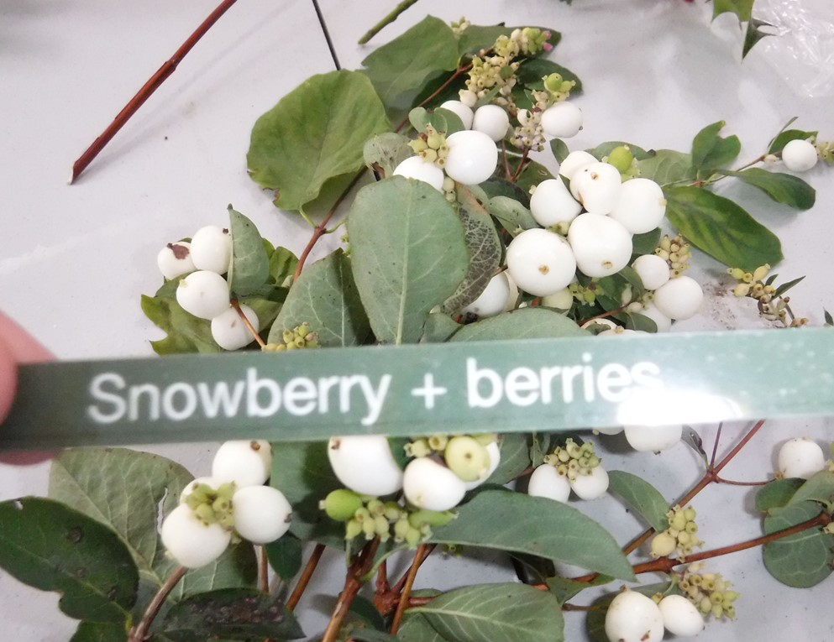
Well done!!
This shrub, grows 1-3 m high. It spreads by suckers and forms large thickets in the woodlands.
The berries are not very attractive to birds but are eaten by pheasants in hard winters. The leaves are food for the caterpillars of Death's-head Hawk-moths.
Snowberries
Click to continue

Slide 25
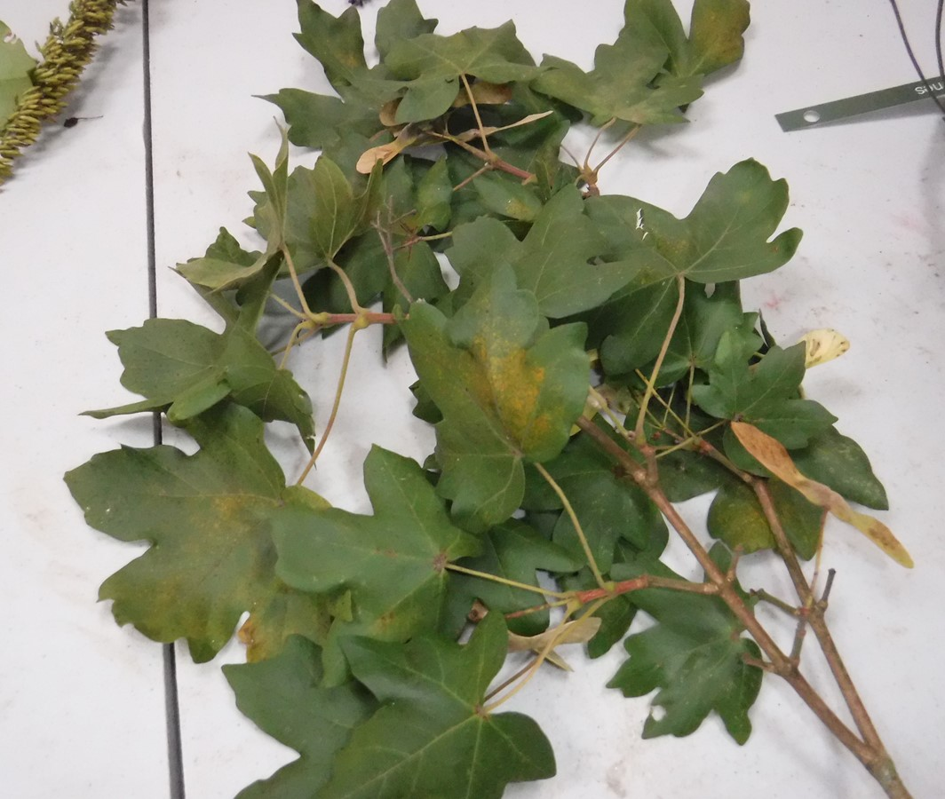
Can you name this plant?
X Try again
sycamore
X Try again
Horse chestnut
Field Maple
Maple
X Try again
Click here for a clue..
This is a flowering plant species in the soapberry and lychee family. In the right conditions can grow 25m tall.
Click on the answer to submit

Slide 26
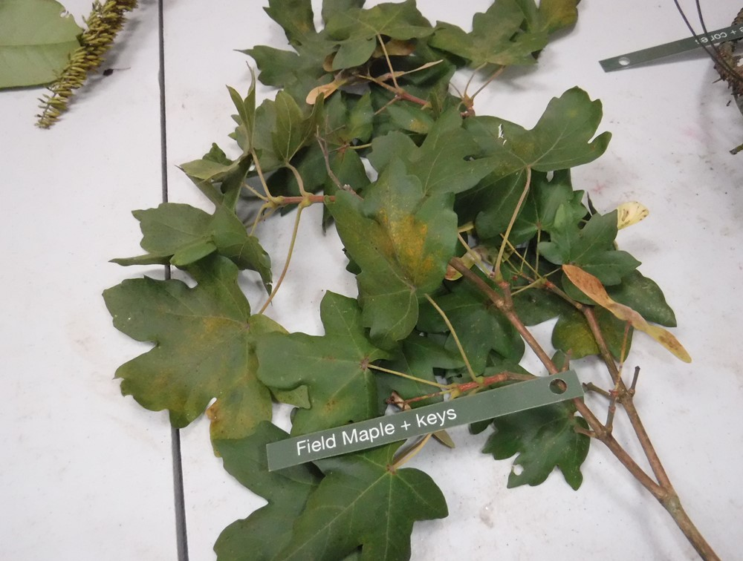
Well done!!
Field maple is a small, deciduous tree which can be up to 25 m tall, but often reaches only 10-15 m in height or remains as a shrub when coppiced. It is found mainly on lime-rich soils in woodland, often as an understory to the oak, or in scrub and hedges. The bark is deeply fissured.
Click to continue
Field Maple & Keys

Slide 27
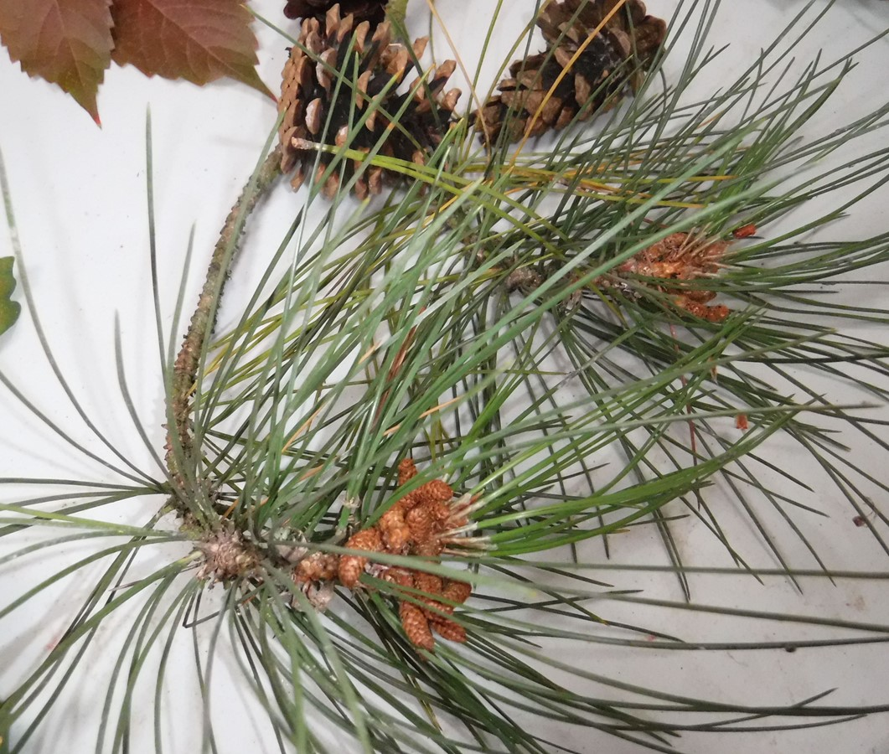
Can you name this plant?
X Try again
Poplar
Pine
X Try again
Yew
Cypress
X Try again
Click here for a clue..
This is a type of conifer. The wood is often used to make furniture.
Click on the answer to submit

Slide 28
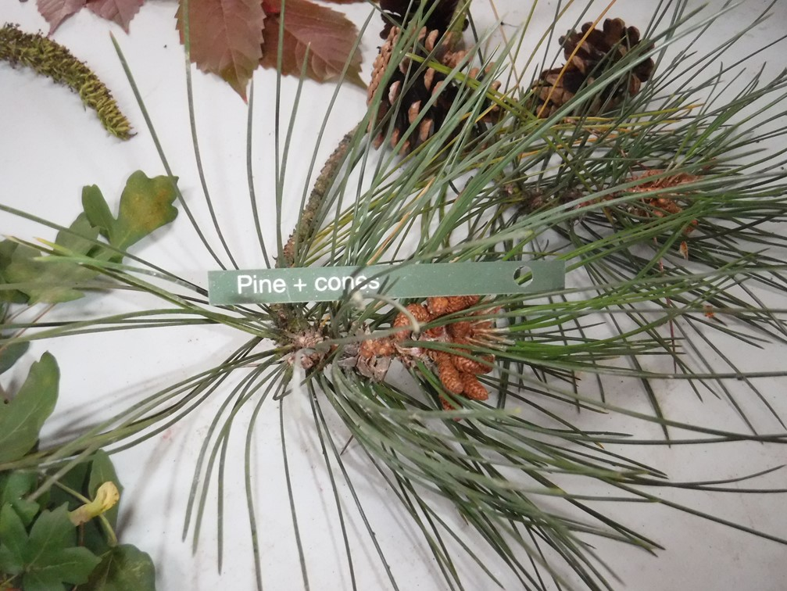
Well done!!
There are over 120 types of pine tree. Pine trees have a life time of 100 to 1,000 years. The oldest known pine is 4,840 years old. It is still alive and is one of the oldest known organisms in the world! They vary in height from just 3 mtrs to 80 mtrs.
Pine & Cones
Click to continue

Slide 29
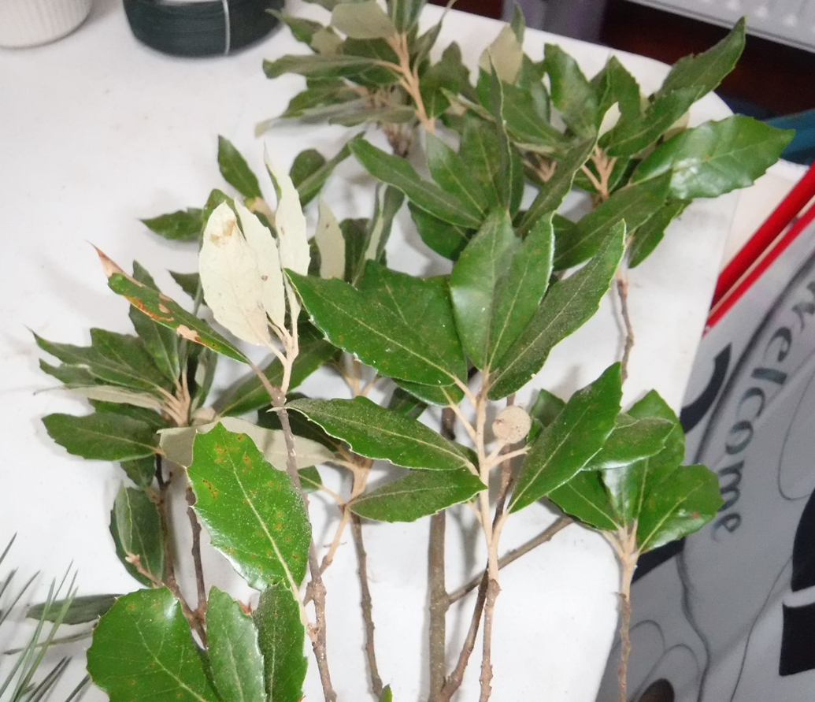
Can you name this plant?
X Try again
Viburnum Tinus
X Try again
Cherry Laurel
X Try again
Lilac
HOLM OAK
Click here for a clue..
The bark is black and finely cracked, and twigs are slender and covered with light brown felt-like hairs.
Click on the answer to submit

Slide 30
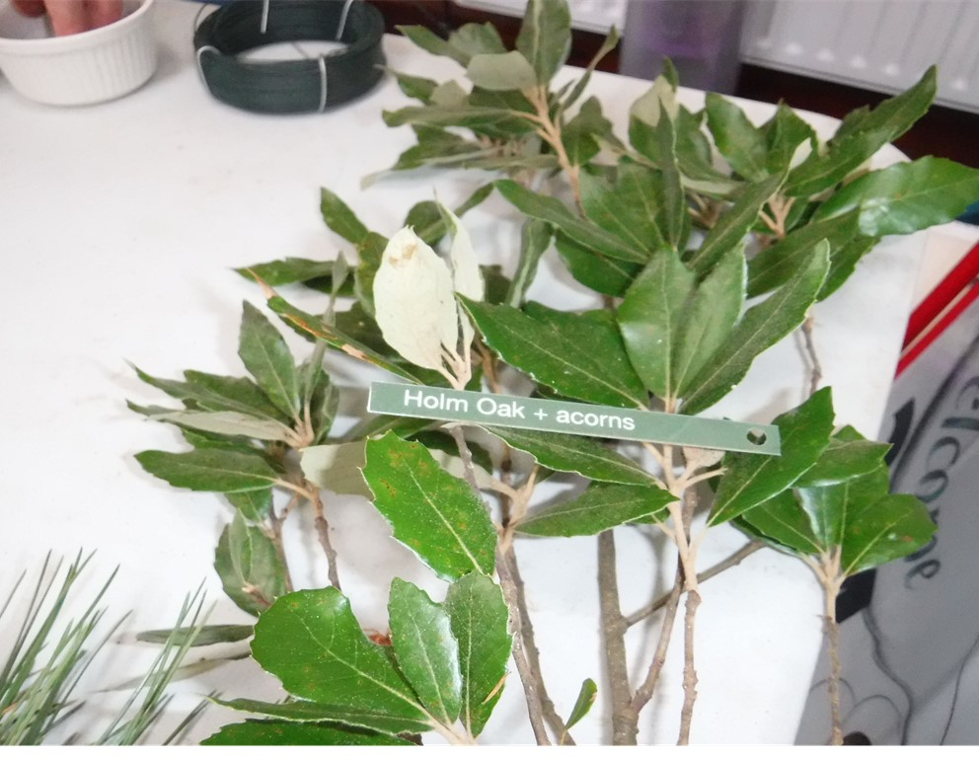
Well done!!
Holm oak is also known as 'holly oak’.
Young leaves and leaves on young plants are spiny, like holly leaves, whereas older leaves and leaves on old plants have smooth edges.
The bark is black and finely cracked, and twigs are slender and covered with light brown felt-like hairs.
Click to continue
Holm Oak

Slide 31
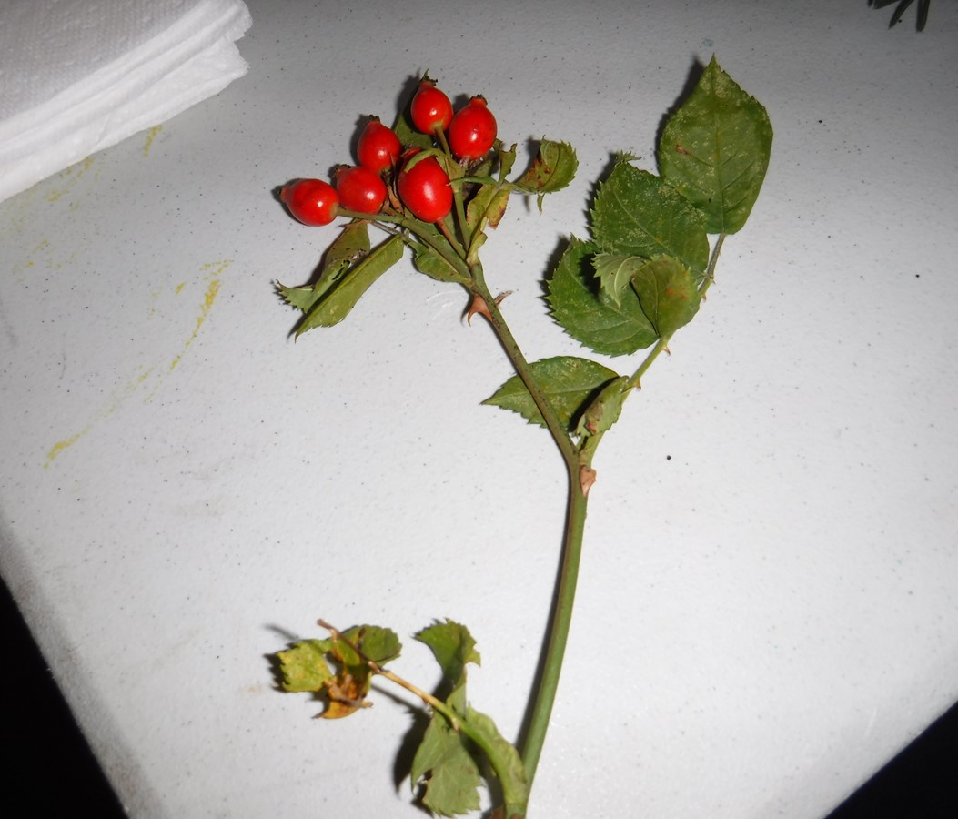
Can you name this plant?
Cotoneaster Horizontalis
X Try again
Dog Rose
X Try again
Firethorn
Hawthorn
X Try again
Click here for a clue..
Flowers: large pink or white five petalled flowers with a faint sweet smell.
Click on the answer to submit

Slide 32
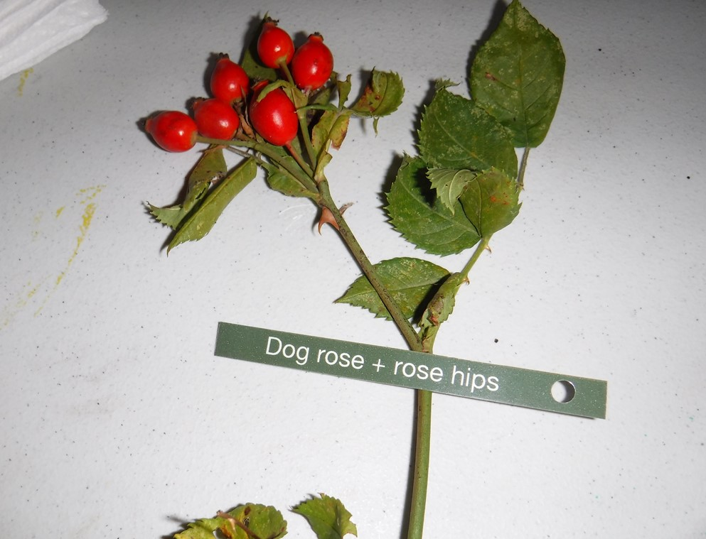
Well done!!
There are many species of wild rose found in the UK which are all very similar and difficult to identify.
Dog rose flowers are an important nectar source for insects.
The fruits are a food source for birds such as blackbirds, redwings and waxwing
Click to continue
Dog Rose

Slide 33
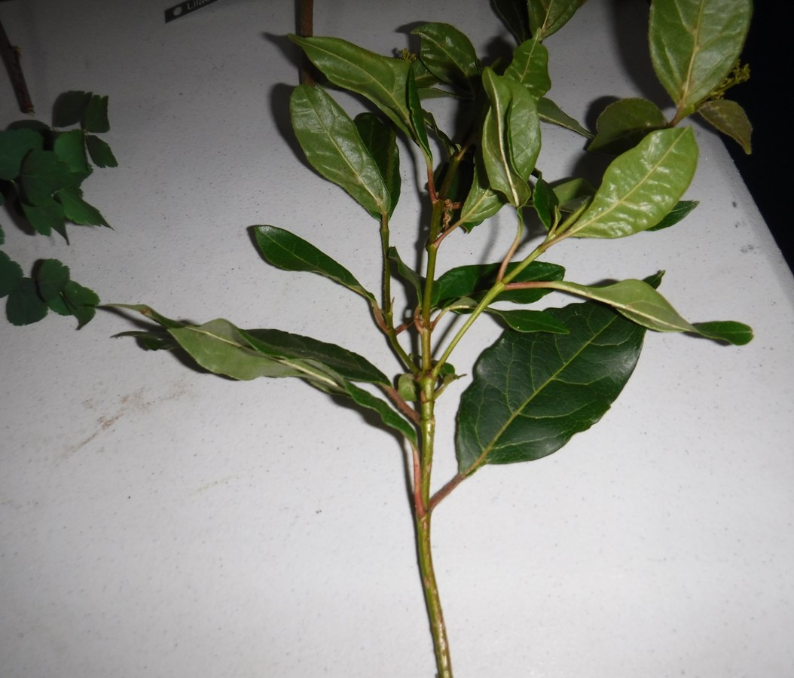
Can you name this plant?
Rose of Sharon
X Try again
X Try again
Ash
X Try again
Wild Cherry
Viburnum Tinus
A dense, evergreen shrub with dark and oval, glossy leaves. produces small pink & white flowers in Spring.
Click here for a clue..
Click on the answer to submit

Slide 34
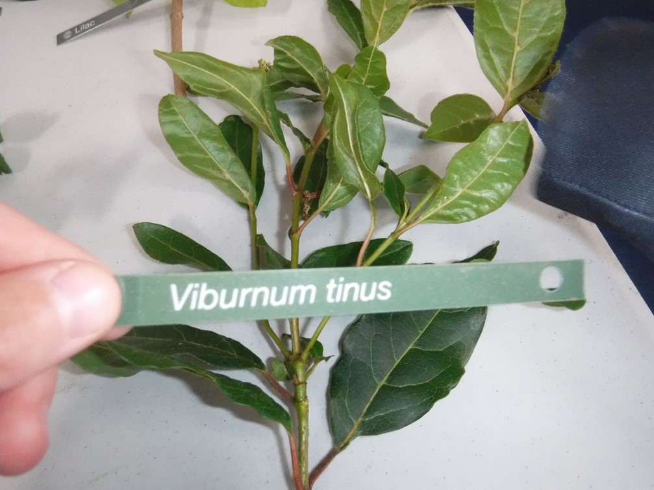
Well done!!
Viburnums are evergreen or deciduous flowering shrubs or small trees and there are at least 150 different species.
In the past, long stems of some species of viburnum have been used as shafts for arrows, and they are still commonly used by archers.
Click to continue
Viburnum tinus

Slide 35
Children's Ministry Churchyard Quiz
Jasmine
Part 3

Slide 36
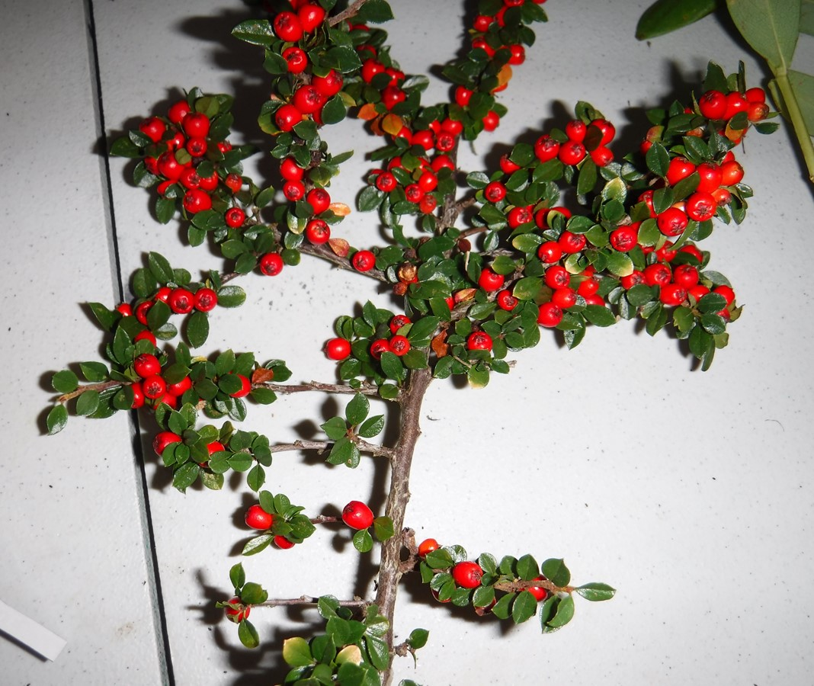
Can you name this plant?
Mistletoe
X Try again
X Try again
English Holly
X Try again
cloudberry
Cotoneaster Horizontalis
Click here for a clue..
Has glossy green leaves and bright red berries in Autumn and Winter (it's not Holly.)
Click on the answer to submit

Slide 37
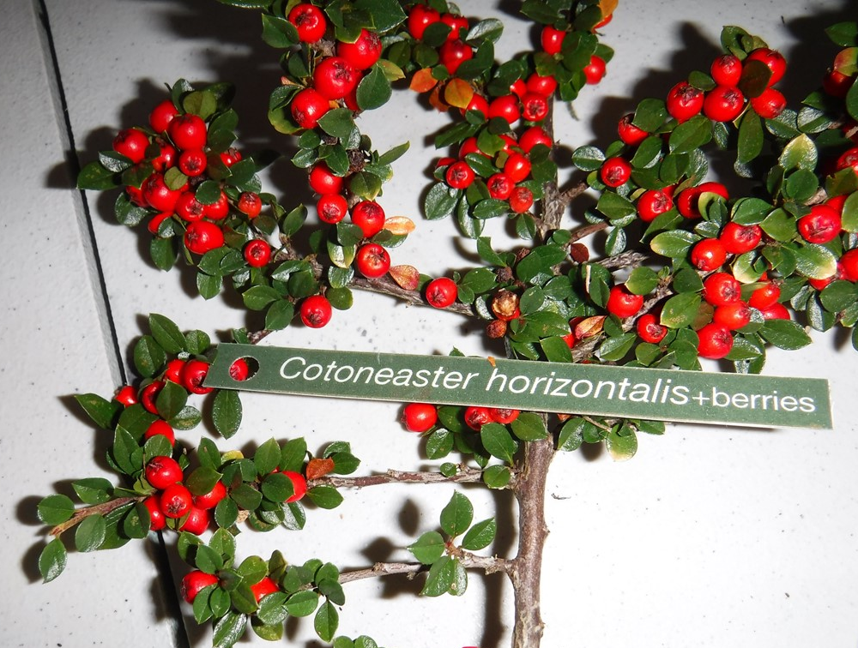
Well done!!
Has glossy green leaves and bright red berries in Autumn and Winter
The red berries are also called pomes.
Click to continue
Cotoneaster Horizontalis

Slide 38
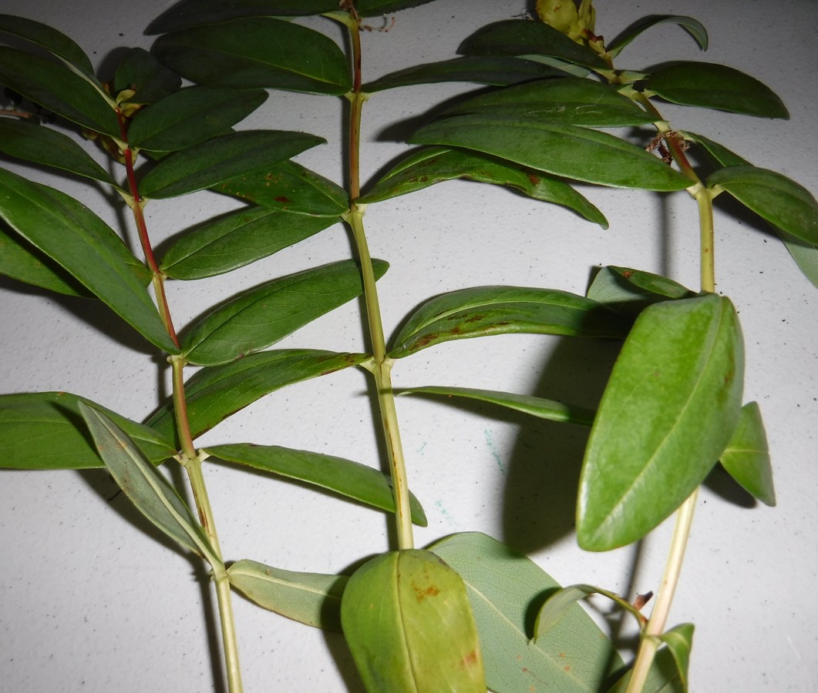
Can you name this plant?
X Try again
Lilac
Rose of sharon
X Try again
Dog rose
buddleia
X Try again
A pink flowering plant and a member of the Mallow family.
Click here for a clue..
Click on the answer to submit

Slide 39
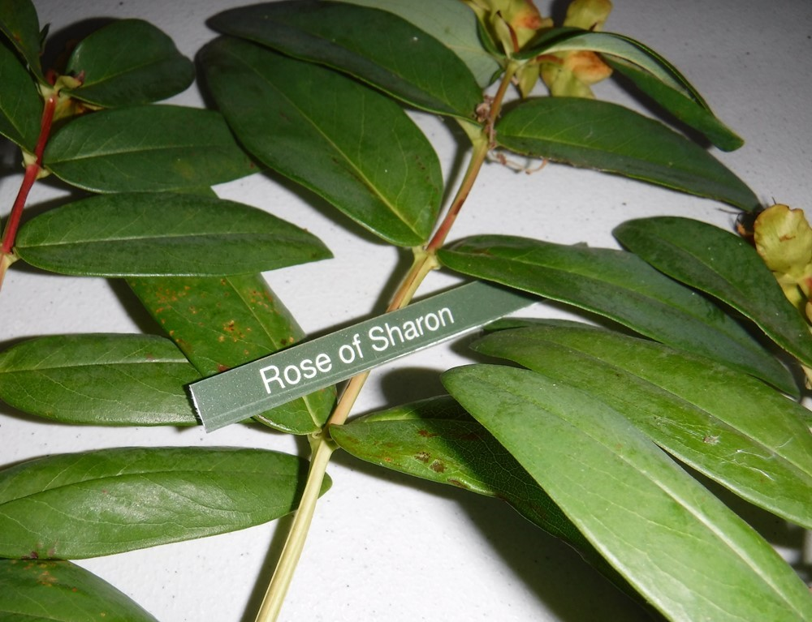
Well done!!
A pink flowering plant and a member of the Mallow family.
The Rose of Sharon is not actually a rose!
Click to continue
Rose of Sharon

Slide 40
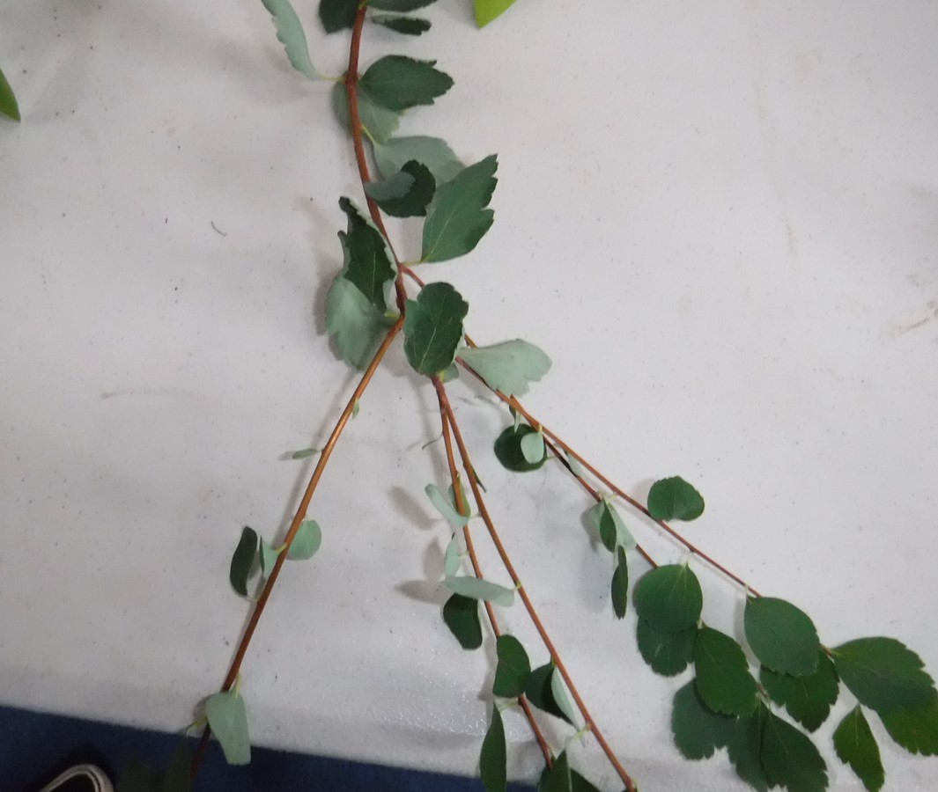
Can you name this plant?
Lilac
X Try again
X Try again
Bramble
X Try again
Firethorn
spirea
Click here for a clue..
Leaves are formed in spiralling patterns and colourful flowers are formed in large clusters. A deciduous plant.
Click on the answer to submit

Slide 41
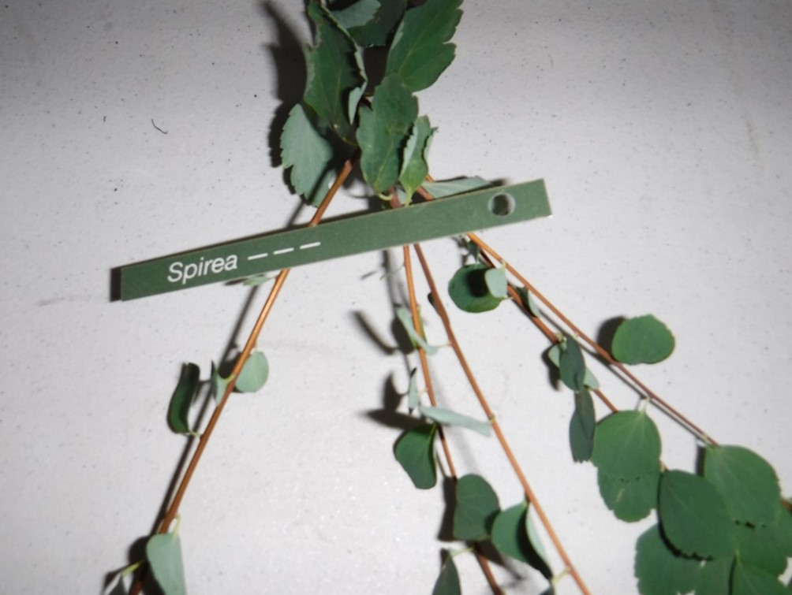
Well done!!
Some flower in Summer, and some flower in Spring.
Leaves are formed in spiralling patterns and colourful flowers are formed in large clusters.
A deciduous plant.
Click to continue
Spirea

Slide 42
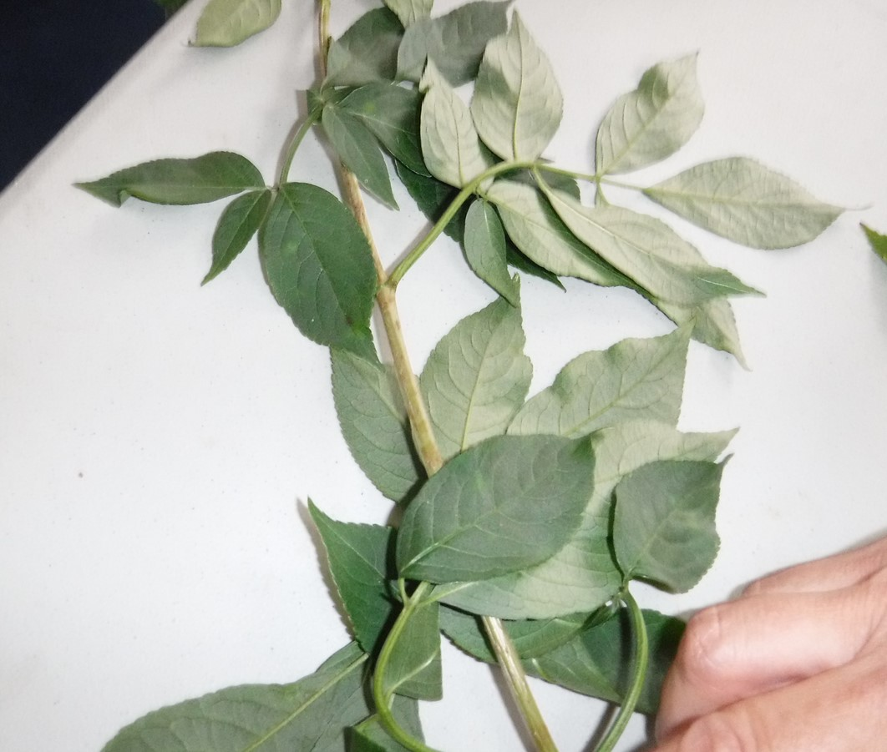
Can you name this plant?
X Try again
English Elm
X Try again
alder
Elder
X Try again
Hazel
The highly scented flowers of this tree are often used to make wine, cordial or tea.
Click here for a clue..
Click on the answer to submit

Slide 43
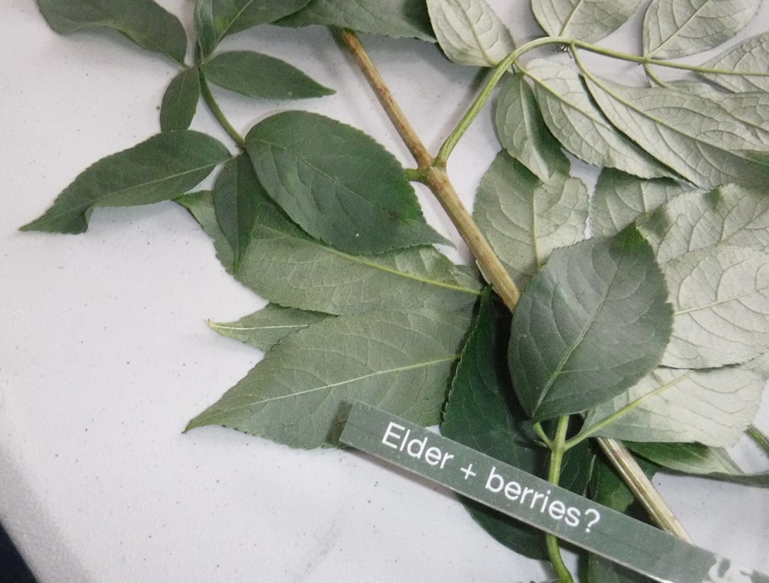
Well done!!
It used to be believed that an Elder tree planted near your house would keep the Devil away.
The highly scented flowers of this tree are often used to make wine, cordial or tea.
Elder
Click to continue

Slide 44
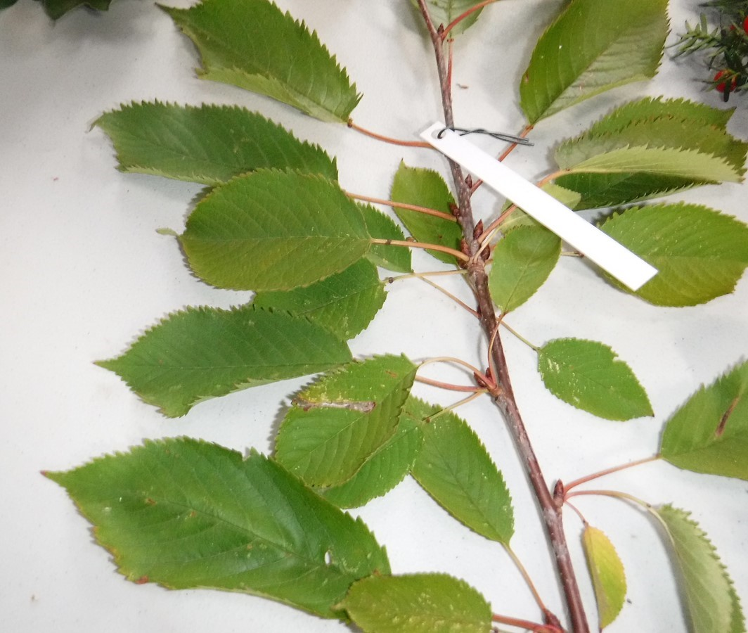
Can you name this PLANT?
Wild Cherry
X Try again
English Elm
X Try again
Damson
X Try again
Ash
The fruit of this tree can be delicious but the pips are poisonous and should not be consumed. Some of the fruits are sweet but others are sharp and sour.
Click here for a clue..
Click on the answer to submit

Slide 45
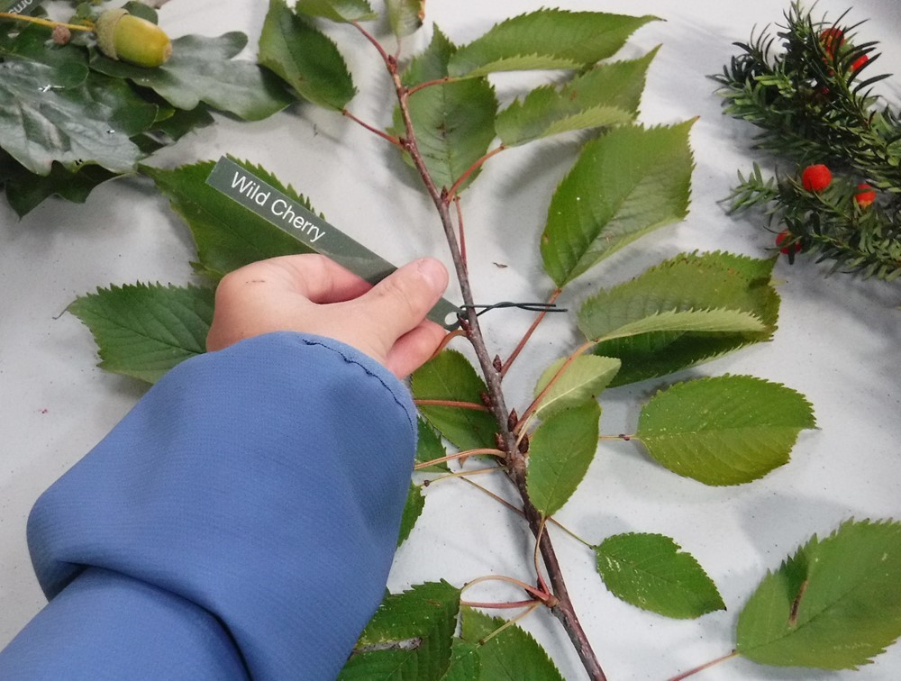
Well done!!
Wild cherries are very edible if you get to them before the birds!
The fruit of this tree can be delicious but the pips are poisonous and should not be consumed. Some of the fruits are sweet but others are sharp and sour.
Wild Cherry
Click to continue

Slide 46
Children's Ministry Churchyard Quiz stella & Rory
Part 4

Slide 47
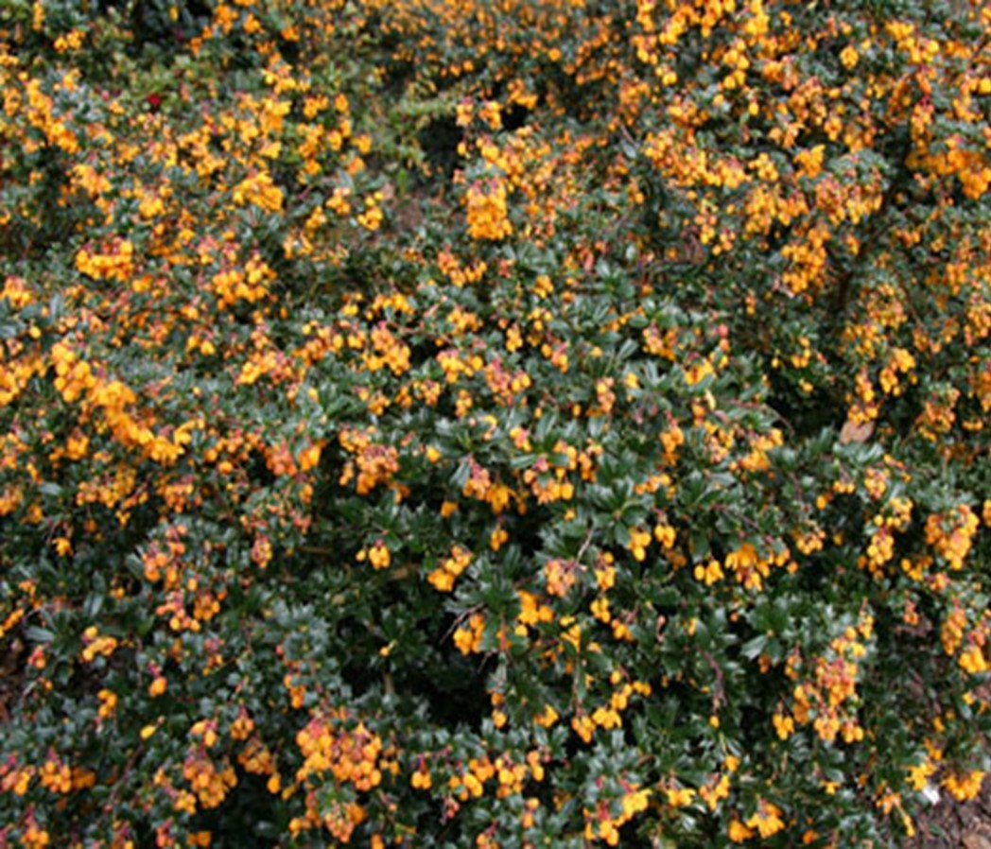
Can you name this PLANT?
Berberis Darwinii
X Try again
Liverworts
X Try again
Cycad
X Try again
Puzzlegrass
Click here for a clue..
If you eat this plant you will get an upset tummy.
Click on the answer to submit

Slide 48
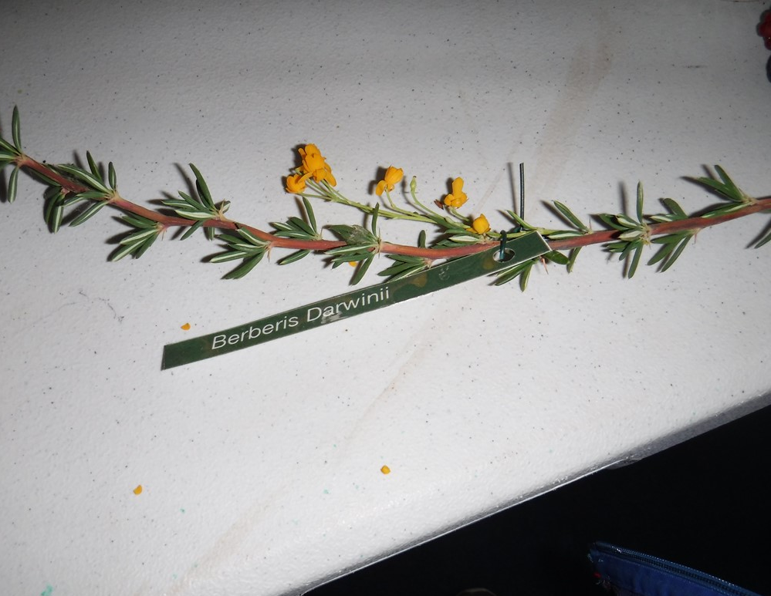
Well done!!
It only grows up to 1.5-2.5 m
If you eat this plant you will get an upset tummy.
Berberis Darwinii
Click to continue

Slide 49
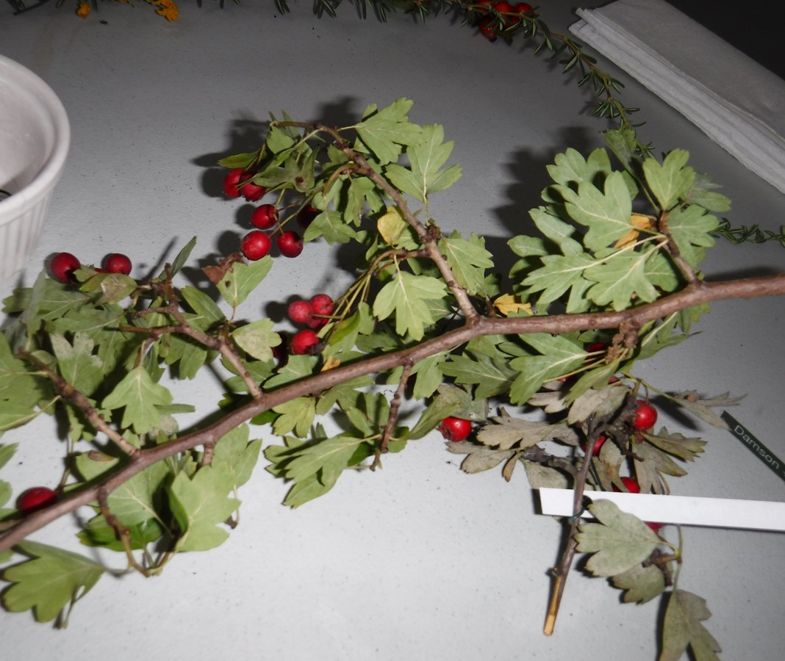
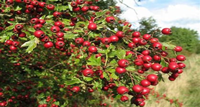
Can you name this plant?
X Try again
Conifers
X Try again
Gnetophtes
X Try again
Hornworts
Hawthorn
Click here for a clue..
This plant can grow in the form of a small plant or thorny shrub.
Click on the answer to submit

Slide 50
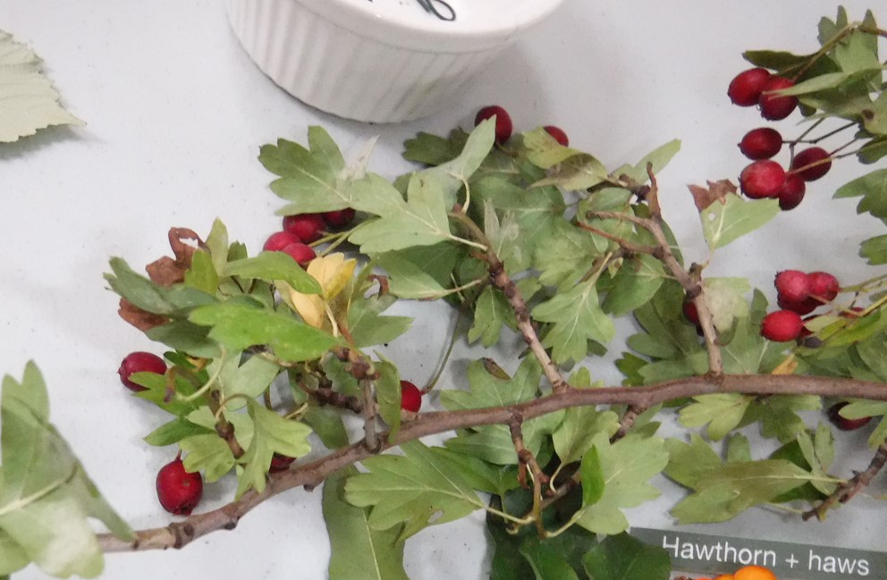
Well done!!
This plant is a versatile tree that thrives in full sunlight and any well- drained soil.
This plant can grow in the form of a small plant or thorny shrub.
Hawthorn & Haws
Click to continue

Slide 51
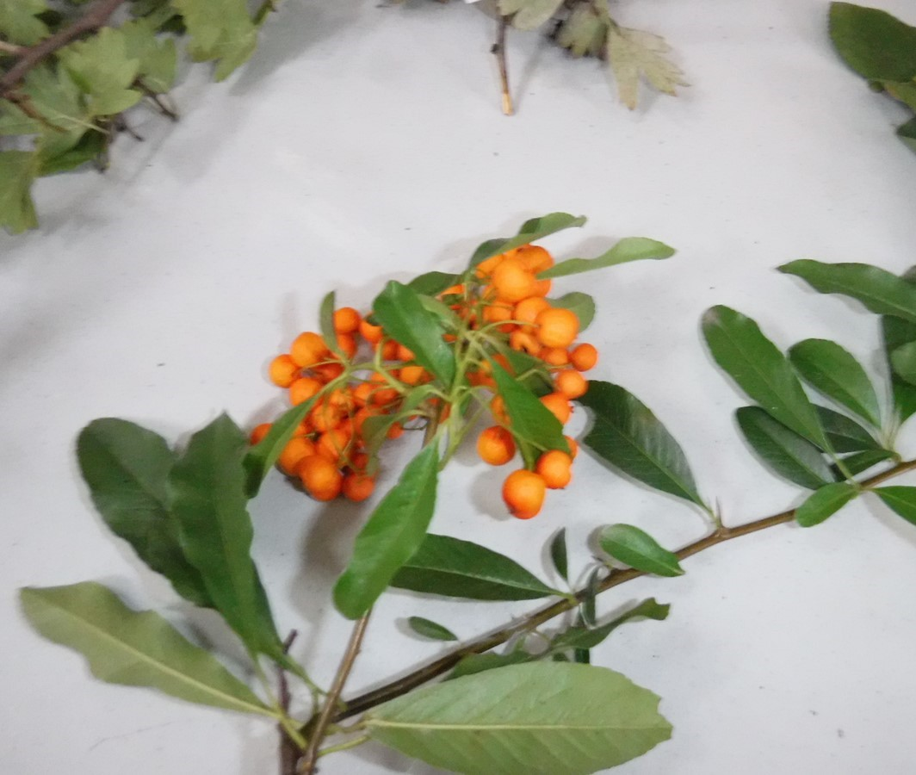
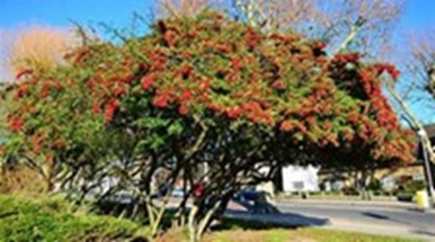
Can you name this plant?
Marattiopsida
X Try again
Firethorn (Pyracantha)
Horneophytopsida
X Try again
Maidenhair tree
X Try again
Click here for a clue..
This plant produces numereos branches covered in long, sharp thorns.
Click on the answer to submit

Slide 52

Firethorn (Pyracantha)
Well done!!
This plant is a prickly shrub that can reach 6-16 feet in height and 5-10 feet in width.
This plant produces numerous branches covered in long, sharp thorns.
Click to continue

Slide 53


Can you name this plant?
X Try again
Rose
X Try again
Mulberry
Alder Buckthorn
X Try again
English Elm
Mature trees can grow up to 30m and can live for more than 100 years.
Click here for a clue..
Click on the answer to submit

Slide 54

Well done!!
Mature trees can grow up to 30m and can live for more than 100 years.
Some varieties are cultivated as dwarf trees, while others can reach the height of 115 feet high.
Click to continue
English Elm

Slide 55


Can you name this plant?
X Try again
Spindle
X Try again
Sycamore
Tutsan
X Try again
Willow Osier
Click here for a clue..
Grows in the Mediterranean area.
Click on the answer to submit

Slide 56


Well done!!
Grows in the Mediterranean area.
Is a member of the hypericum genus family.
Tutsan
Click to continue

Slide 57
Children's Ministry Churchyard Quiz
Coming Soon
Part 5

Slide 58
Children's Ministry Churchyard Quiz
Coming Soon
Part 6

Slide 59

We hope you had fun?

